Slide 1
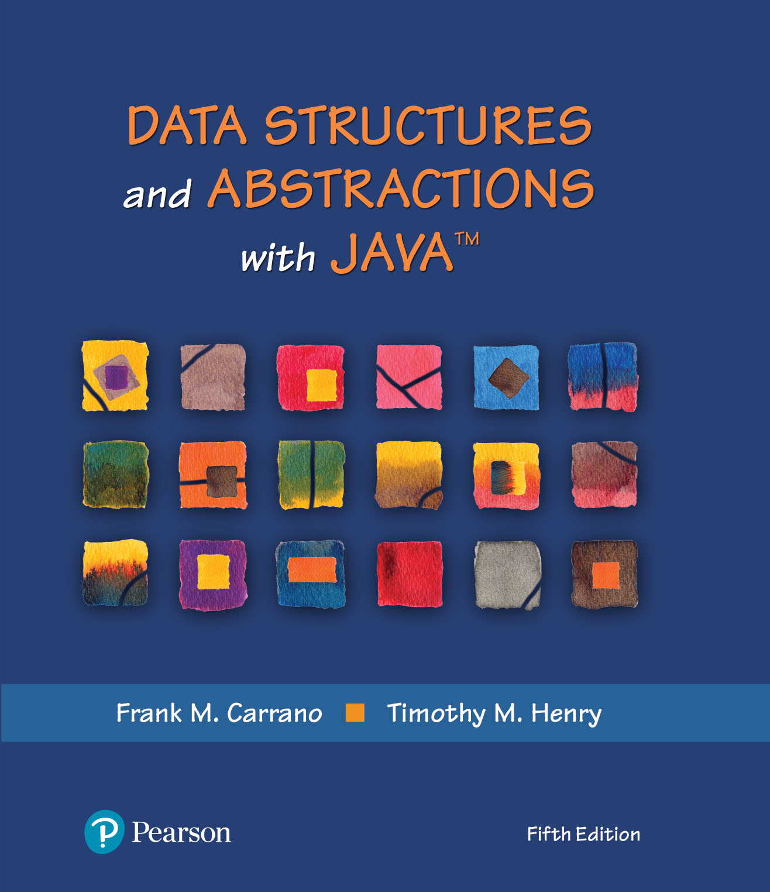
Module 6
Chapter 4 - The Efficiency of Algorithms

Slide 2
Video Notes
Measuring Efficiency
https://mediaplayer.pearsoncmg.com/assets/secs-vn-ch04a-measuring-efficiency
Comparing Bag Implementations
https://mediaplayer.pearsoncmg.com/assets/secs-vn-ch04b-comparing-bag-implementations
Notes:
To maximize your learning experience, prepare for class prior each week

Slide 3
Additional Resources
Introduction to Big O Notation and Time Complexity
https://www.youtube.com/watch?v=D6xkbGLQesk&feature=youtu.be
https://www.youtube.com/watch?v=bum_19loj9A&list=PLBZBJbE_rGRV8D7XZ08LK6z-4zPoWzu5H
Big O Quadratic Time Complexity
https://jarednielsen.com/big-o-quadratic-time-complexity/
Notes:
To maximize your learning experience, prepare for class prior each week

Slide 4
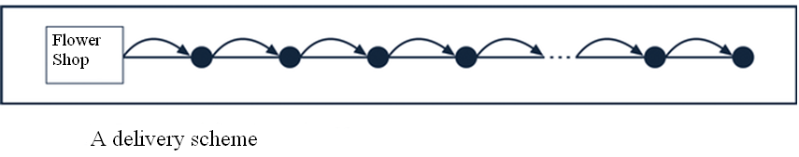
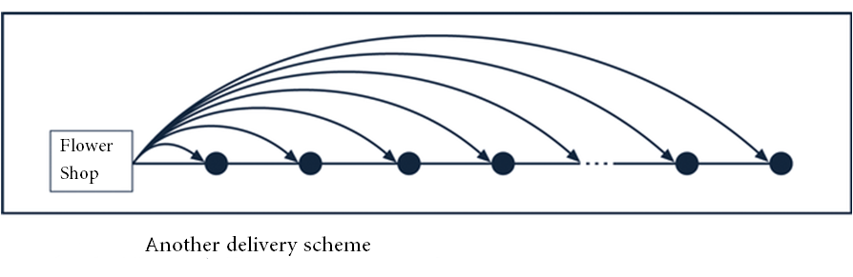

Efficiency | Trade Off Analysis
A flower shop has multiple deliveries to make. What algorithm should they use?
Notes:
No matter what we do, we try to be effective about it
Same expectation in programming
What are the trade-offs?

Slide 5
Efficient Code
What’s efficient code?
Computers are faster, have larger memories
So why worry about efficient code?
Space vs. time analysis
How we measure efficiency
What’s more important? Why?
N : Number of elements (amount of data)
CMSC 203: 0 <= n <= 50
CMSC 204: Think Big Data
Readability
Notes:
Don’t overlook readability. The lifetime of a piece of code could last a decade or longer. Maintenance will become an issue if a piece of code is not easy to read

Slide 6

Importance of Efficiency
Consider the problem of summing (running total)
Algorithm A | Algorithm B | Algorithm C
int sum = 0; for (int i = 1; i <= n; i++) sum = sum + i; | sum = 0; for (int i = 1; i <= n; i++) { for (int j = 1; j <= i; j++) sum = sum + 1; } // end for | sum = n * (n + 1) / 2;
Different approaches to solve the same problem
Which one will run faster? Test them out using 1,000,000 elements to find out
Notes:
All 3 algorithms will produce the same result
Algorithm A is the most “intuitive” way (from 140)
Is 1,000,000 elements a “large” dataset? Not really
Critical section of code

Slide 7
Counting Basic Operations
A basic operation of an algorithm
Most significant contributor to its total time requirement
 | Algorithm A | Algorithm B | Algorithm C
 | int sum = 0; for (int i = 1; i <= n; i++) sum = sum + i; | sum = 0; for (int i = 1; i <= n; i++) { for (int j = 1; j <= i; j++) sum = sum + 1; } // end for | sum = n * (n + 1) / 2;
Additons | n | n(n + 1)/2 | 1
Multiplications | 0 | 0 | 1
Divisions | 0 | 0 | 1
Total Basic Operations | n | (n² + n)/2 | 3
Notes:
How do we determine efficiency? We evaluate its basic operations
Algorithm C would be the most efficient one, regardless how big n might be

Slide 8
Counting Basic Operations
n | (log(log n) | log n | log² n | n | n log n | n² | n³ | 2^{n} | n!
10 | 2 | 3 | 11 | 10 | 33 | 10² | 10³ | 10³ | 10⁵
10² | 3 | 7 | 44 | 100 | 664 | 10⁴ | 10⁶ | 10³⁰ | 10⁹⁴
10³ | 3 | 10 | 99 | 1,000 | 9,966 | 10⁶ | 10⁹ | 10³⁰¹ | 10¹⁴³⁵
10⁴ | 4 | 13 | 177 | 10,000 | 132,877 | 10⁸ | 10¹² | 10³⁰¹⁰ | 10^{19,335}
10⁵ | 4 | 17 | 276 | 100,00 | 1,660,964 | 10¹⁰ | 10¹⁵ | 10^{30,103} | 10^{243,338}
10⁶ | 4 | 20 | 397 | 1,000,000 | 19,931,569 | 10¹² | 10¹⁸ | 10^{301,301} | 10^{2,933,369}
Typical growth-rate functions evaluated at increasing values of n
Notes:
Different algorithms will yield different results as n gets big
It would be ideal if our method’s growth rate is log(log n) – best case

Slide 9
Picturing Time Efficiency
Growth-Rate Function g | g(10⁶) / 10⁶
log n | 0.0000199 seconds
n | 1 second
n log n | 19.9 seconds
n² | 11.6 days
n³ | 31,709.8 years
2^{n} | 10^{301,016} years
The time required to process one million items by algorithms of various orders at the rate of one million operations per second
Notes:
We should avoid any algorithm (code) with a n² or higher growth rate, if we can help it
Example: we are driving to Miami, which route would you take? 20 vs. 40 hours?

Slide 10
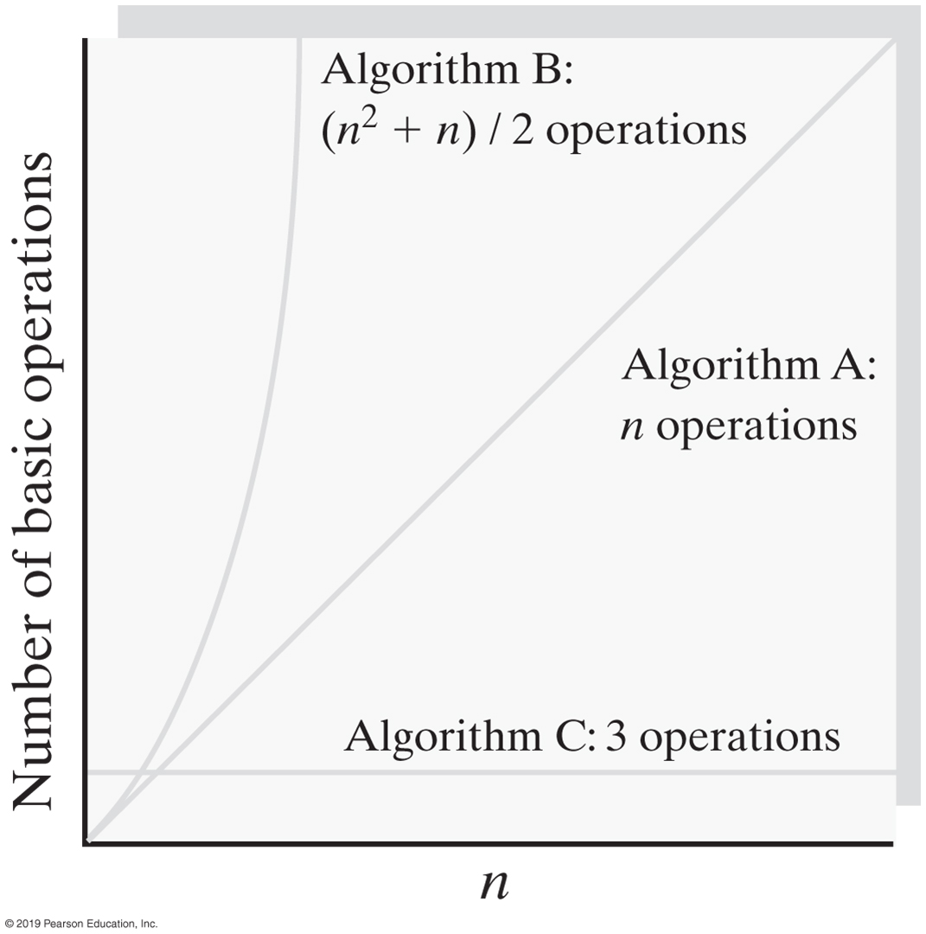
Growth Rates
Notes:
As n gets bigger, here are the expected results
Algorithm C is what you want (as n gets bigger, it’s still VERY efficient)
Big O – Order of magnitude

Slide 11
Best, Worst & Average Cases
Goal is to know best, worst and average cases, why?
Best case
Worst case
Average case
For some algorithms, execution time depends only on size of data set
Other algorithms depend on the nature of the data itself
Notes:
Efficiency == thinking about worst case
Murphy’s law

Slide 12
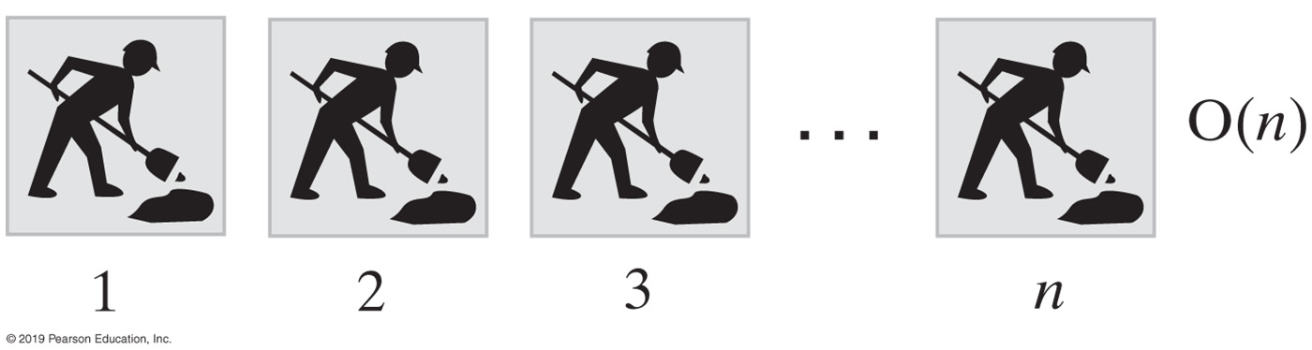
Big O Notation (Picturing Efficiency)
An O(n) algorithm
int sum = 0;
for (int i = 1; i <= n; i++)
sum = sum + i;
Above code depends on n. As n gets big, the function will take n times longer to complete
Notes:
The for loop is depended on n

Slide 13
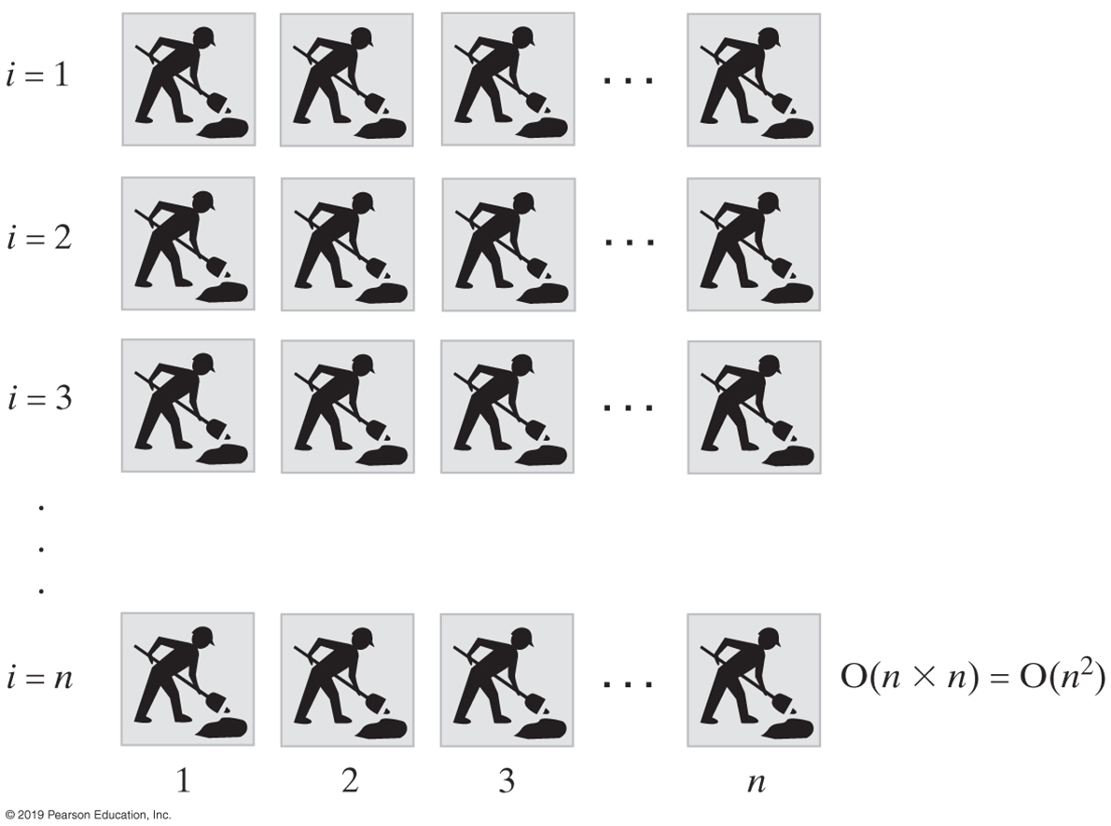
An O(n²) algorithm
sum = 0;
for (int i = 1; i <= n; i++)
{
for (int j = 1; j <= n; j++)
sum = sum + 1;
} // end for
Notes:
O(n*n) vs. 2*O(n)

Slide 14
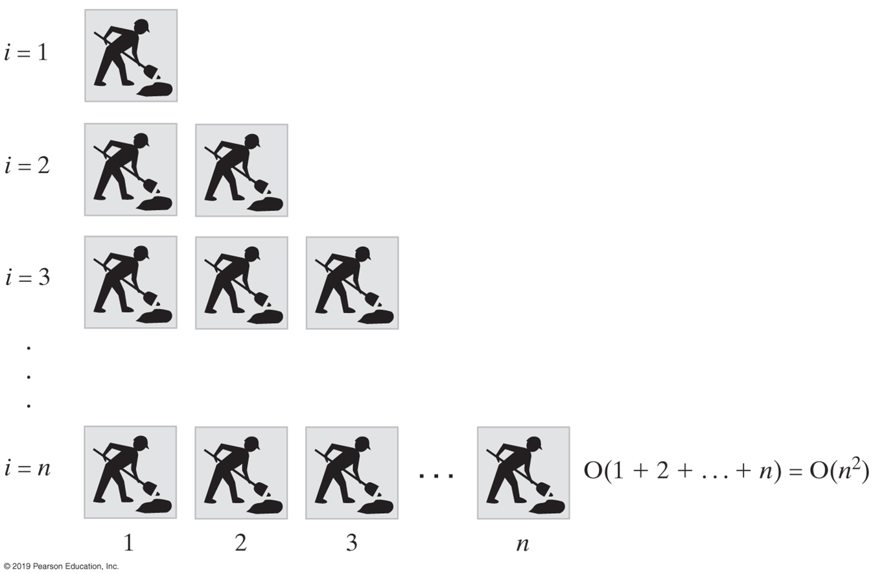
Another O(n²) algorithm
sum = 0;
for (int i = 1; i <= n; i++)
{
for (int j = 1; j <= i; j++)
sum = sum + 1;
} // end for
Notes:
Both loops depend on n

Slide 15
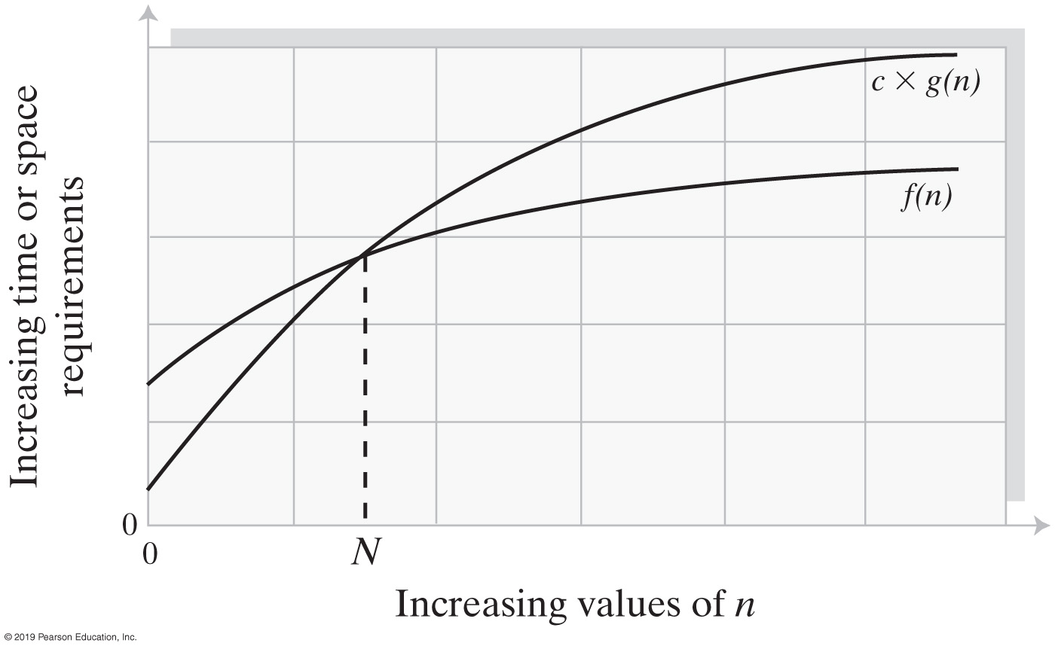
Big Oh Notation
An illustration of the values of two growth-rate functions
Notes:
Big O represents order of magnitude

Slide 16
More Examples

Slide 17
Constant - O(1)
O(1) describes an algorithm that will always execute in the same time (or space) regardless of the size of the input data set
bool IsFirstElementNull(String[] strings)
{
if(strings[0] == null)
{
return true;
}
return false;
}
Rob Bell
A beginners Guide to Big O Notation
rob-bell.net/2009/06/a-beginners-guide-to-big-o-notation/
Notes:
O(1) annotates “the same” as n grows
We say O(1) as oppose to O(5)

Slide 18
Linear - O(n)
Example illustrates how Big O represents the worst-case performance scenario
Even though a matching string could be found during any iteration of the for loop and the function would return early, Big O (notation) will always assume the upper limit where the algorithm will perform the maximum number of iterations
bool ContainsValue(String[] strings, String value)
{
// additional logics before and after this critical section
for(int i = 0; i < strings.Length; i++)
{
if(strings[i] == value)
{
return true;
}
} return false;
}
Rob Bell
A beginners Guide to Big O Notation
rob-bell.net/2009/06/a-beginners-guide-to-big-o-notation/

Slide 19
Polynomial - O(n²)
An algorithm whose performance is directly proportional to the square of the size of the input data set. This is common with algorithms that involve nested iterations over the data set. Deeper nested iterations will result in O(n³), O(n⁴) etc.
bool ContainsDuplicates(String[] strings) {
for(int i = 0; i < strings.Length; i++)
{
for(int j = 0; j < strings.Length; j++)
{
if(i == j) // Don't compare with self
{
continue;
}
if(strings[i] == strings[j])
{
return true;
}
}
}
return false;
}
Rob Bell
A beginners Guide to Big O Notation
rob-bell.net/2009/06/a-beginners-guide-to-big-o-notation/

Slide 20
Exponential - O(2^{n})
int Fibonacci(int n)
{
if (n <= 1)
return n;
else
return Fibonacci(n - 1) + Fibonacci(n - 2);
}
Growth will double with each additional element in the input data set. The execution time of an O(2^{N}) function will quickly become very large
Recursive calculation of Fibonacci numbers
Rob Bell
A beginners Guide to Big O Notation
rob-bell.net/2009/06/a-beginners-guide-to-big-o-notation/

Slide 21
Growth Rates

Slide 22
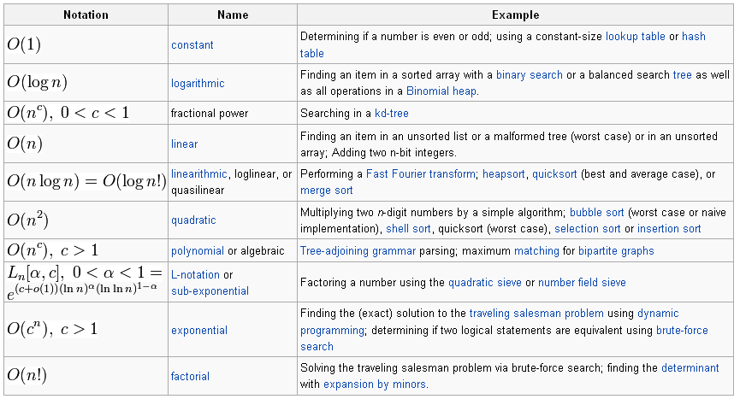
Orders of Common Functions
From Wikipedia, the free encyclopedia
Notes:
Most methods that we implement will likely be one of the above common functions

Slide 23
Additional Resources
Big O Notation - explained as easily as possible
https://thatcomputerscientist.com/big-o-notation-explained-as-easily-as-possible
Analysing Algorithms: Worst Case Running Time
https://thatcomputerscientist.com/analysing-algorithms-worst-case-running-time

Slide 24
Algorithm Speed Analysis Technique
Identify the most critical section of code, look for the inner most nested loop
Determine the maximum number of times this loop executes as a function of n, the maximum value of the loop variable(s)
For data structures, n is often the number of nodes in the structure
Big-Oh value of the function is the relative speed
Example: Binary search algorithm is O(log n)

Slide 25
Binary Search
Generalizing T = log2n

Slide 26
Binary Search
low = 0;
high = n - 1
i = (high - low) / 2;
while (searchValue != data[i] && high != low)
{ if(searchValue < data[i])
{ high= i - 1 } // move high down to eliminate the upper half of the sub-array
else
{ low = i + 1 } // move low up to eliminate the lower half of the sub list
i = (high + low) / 2;
}
If n is the size of the array, the while loop executes a maximum of log₂(n-1) times

Slide 27
Efficiency of ADT Bag
Operation | Fixed-Size Array | Linked
add(newEntry) | O(1) | O(1)
remove() | O(1) | O(1)
remove(anEntry) | O(1), O(n), O(n) | O(1), O(n), O(n)
clear() | O(n) | O(n)
getFrequencyOf(anEntry) | O(n) | O(n)
contains(anEntry) | O(1), O(n), O(n) | O(1), O(n), O(n)
toArray() | O(n) | O(n)
getCurrentSize(), isEmpty() | O(1) | O(1)
The time efficiencies of the ADT bag (or any ADT) operations for two implementations, expressed in Big Oh notation
Notes:
Why is it important to understand at the method level?
Different ADTs serve different purposes. What do I mean? Google, search vs. sorted

